Slide 1
Velocity kinematics in 2D

Slide 2
Introduction
The rate of change of a pose
We're interested in the relationship between the velocity of the joint angles and the velocity of the end effector.
We're interested in the derivative of the end effector pose.
what exactly does it mean to take the derivative of the pose of the end effector of a robot

Slide 3
Velocity Transform

Slide 4
Tool Tip velocity
q1 dot is joint angle velocity

Slide 5
Tool Tip Velocity

Slide 6
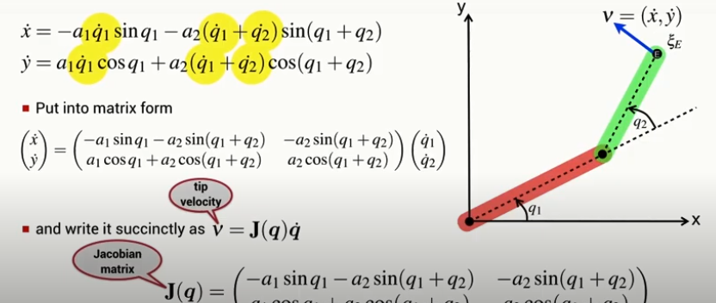
Tool Tip Velocity

Slide 7
Jacobian Matrix
The Jacobian is simply the matrix equivalent of the derivative.
It's the derivative of a function whose argument is a vector and whose result is a vector.
Now those vectors don't have to be the same length.
In our example, x is a vector of n dimensions and y is a vector of m dimensions.
So the Jacobian is a matrix and it will be in this case an n by m matrix.
The elements of the matrix are the partial derivatives of each of the outputs of the function with respect to each of the inputs to the function.

Slide 8
Jacobian Matrix

Slide 9
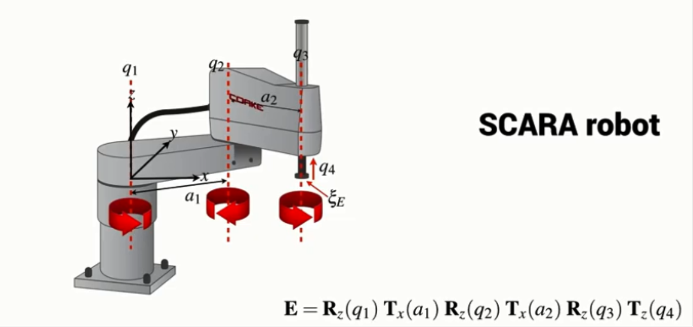
3-link planar robot
The rotational velocity of the end-effector is considered

Slide 10
Tool Tip Pose

Slide 11
Tool Tip Pose

Slide 12
Tool Tip Pose

Slide 13
Tool Tip Pose

Slide 14
Tool Tip Pose

Slide 15
Tool Tip Velocity

Slide 16
Transforming spatial velocity between frames
We can derive a Jacobian which relates the velocity of a point, defined relative to one coordinate frame, to the velocity relative to a different coordinate frame.

Slide 17
Transforming spatial velocity between frames
We have a coordinate frame denoted A and we have a point.
Now that point is moving.
It’s got a spacial velocity, nu, with respect to frame A
It’s got translational velocity component, X dot and Y dot and a rotational velocity component theta dot

Slide 18
Transforming spatial velocity between frames
Lets introduce another coordinate frame, a red coordinated frame denoted B and we have a relative pose that describes the pose of frame B with respect to the pose of frame A.
The velocity of the point with respect to coordinate frame B has to be defined

Slide 19
Transforming spatial velocity between frames
The velocity of the point with respect to frame B is related to the velocity with respect to frame A and it’s related by a Jacobian matrix, a Jacobian that maps velocity from one frame to another.
This particular Jacobian is a function of the relative pose between the two frames.
It’s a three by three matrix that comprises the rotational part of the relative pose and a bunch of zeros and ones.
It is only a function of the relative orientation between the frames.
It doesn't depend at all on the distance between the origins of these two frames.

Slide 20
Transforming spatial velocity between frames

Slide 21
Vision and Motion

Slide 22
Vision and Motion

Slide 23
Vision and Motion

Slide 24
Vision and Motion

